Slide 1
SAP BTP Build Apps Training
Day 9
Anubhav Oberoy
www.AnubhavTrainings.com
Follow excellence with sheer passion

Slide 2


DISCLAIMER
The training content and delivery of this presentation is confidential, and cannot be recorded, or copied and distributed to any third party, without the written consent of Anubhav Trainings

Slide 3
Agenda – Day 9
01
Design the process
02
Enable API Trigger
03
Understand cloud security

Slide 4
Deploy the BPA process
Design time object
process
Runtime object
process
deploy
We can check the control tower > environment,> process > triggers when open the same we can find the API and the context.

Slide 5


Scenario
Build Process Automation
BTP
Sales Order
(Build Apps)
approval
<cartID>
app
rej
Manager
<data>
Sales Representative
Build workzone
My Inbox
Cloud
<<Cart data>>

Slide 6
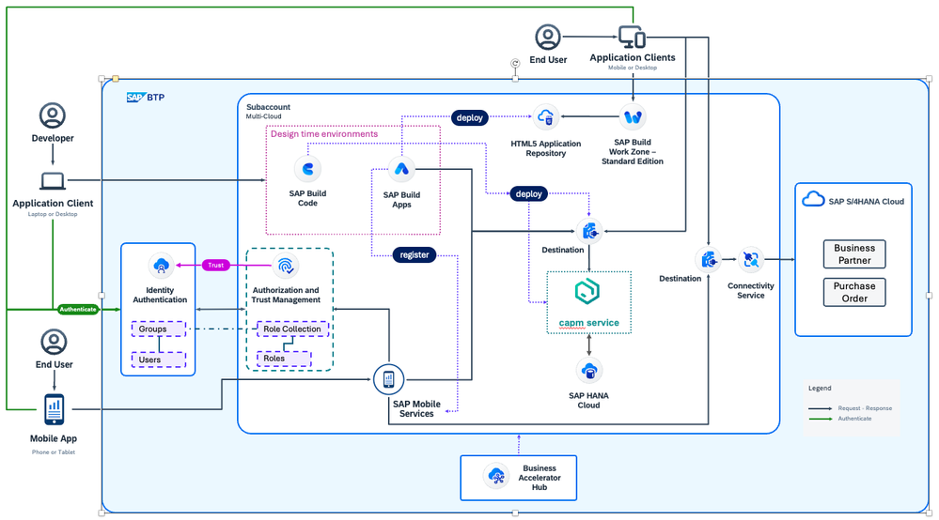

Slide 7
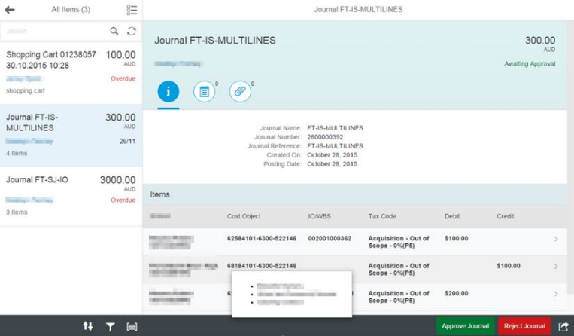
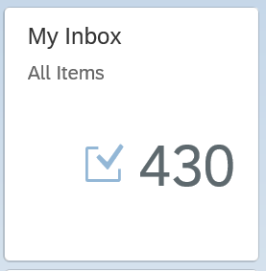
My Inbox Fiori App
In SAP Business Technology Platform (BTP), the Inbox Fiori app typically refers to an application that provides a centralized view for managing tasks and notifications within the system. This app allows users to handle workflow tasks and process approvals directly from within the Fiori interface.
Here are some key points about the Inbox Fiori app:
1. Task Management: It provides an interface where users can view, manage, and act upon their tasks. These tasks can be related to business workflows, approvals, or notifications that need attention.
2. Integration with SAP Workflow: The Inbox app is often integrated with SAP Business Workflow, allowing users to interact with tasks that are part of larger business processes.
3. User-Friendly Interface: As part of the Fiori design principles, the app offers a simple, intuitive, and responsive user interface that can be accessed on desktop and mobile devices.
4. Real-Time Updates: Users are notified of new tasks, and updates to tasks are reflected in real-time, ensuring that users can stay on top of their workload.
6. Access Control: Only users with appropriate roles and permissions can access specific tasks, ensuring that the right people are notified and able to act on the tasks.

Slide 8





















Slide 9
The destination sap_process_automation_service
https://help.sap.com/docs/build-process-automation/sap-build-process-automation/configure-sap-build-process-automation-destinations

Slide 10

The Postman tool
Postman is a popular API (Application Programming Interface) testing and development tool. It provides an easy-to-use interface for interacting with APIs, enabling developers, testers, and other users to test, debug, and document APIs efficiently. It is widely used in the software development lifecycle to ensure that APIs function as intended.
Send requests (GET, POST, PUT, DELETE, etc.) to APIs and receive responses.
Validate the API’s behavior, response codes, and data.
Simplifies sending HTTP requests without needing to write complex scripts.
Supports various authentication methods like OAuth, Basic Auth, Bearer Token, etc.
Reduces manual effort by automating repetitive tasks.
Helps in documenting APIs for better team understanding.
Integrates well into agile and DevOps workflows.
It is available as a desktop application, web application, and browser extension, making it accessible across different platforms.
https://www.postman.com/downloads/

Slide 11
APIs on API HUB
https://api.sap.com/api/SAP_CP_Workflow_CF/resource/Workflow_Instances

Slide 12













SAP BTP CF Security Concept

Slide 13
Scenario
https://help.sap.com/docs/build-process-automation/sap-build-process-automation/configure-sap-build-process-automation-destinations

Slide 14

What We Did
Let’s Summarize

Slide 15

www.anubhavtrainings.com
Thank You
End of Day 9

Slide 16


We’re committed to empower you to be
#FutureReady
through powerful training solutions.
We build the workforce of the future.
250+
Corporate Clients
30,000+
Learners Trained
25000+
Learners Placed
FREE WEBINARS
Sign up for free webinars with industry experts every fortnight!
Enroll Now!
Contact us today!
https://anubhavtrainings.com

